Slide 1




hBP-Fi: Contactless Blood Pressure Monitoring via Deep-Analyzed Hemodynamics
Yetong Cao∗, Shujie Zhang†, Fan Li∗, Zhe Chen‡, Jun Luo†
*Beijing Institute of Technology, China
†Nanyang Technological University, Singapore
‡Fudan University, China
INFOCOM 2024

Slide 2
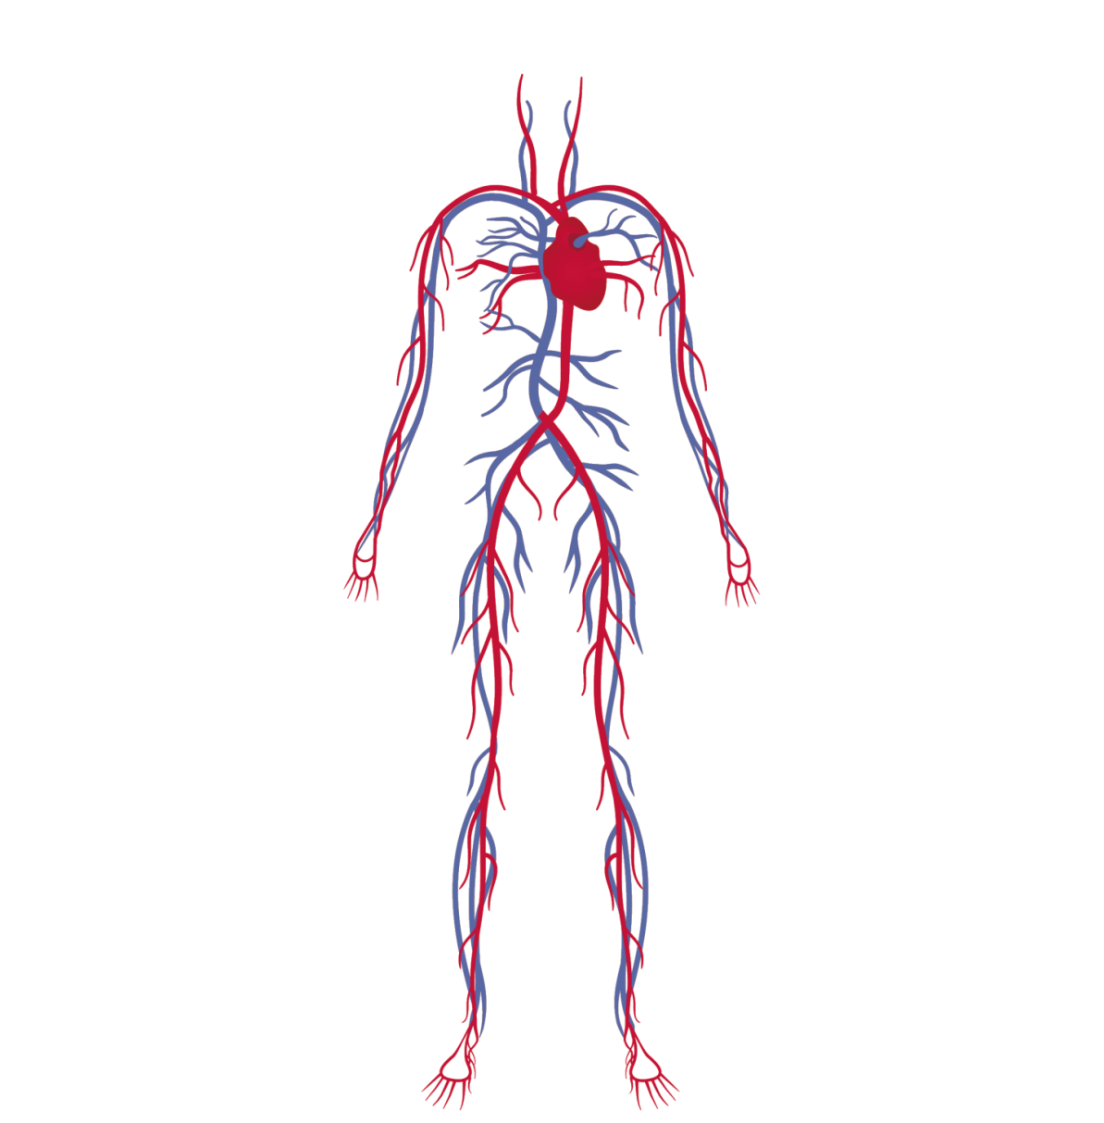
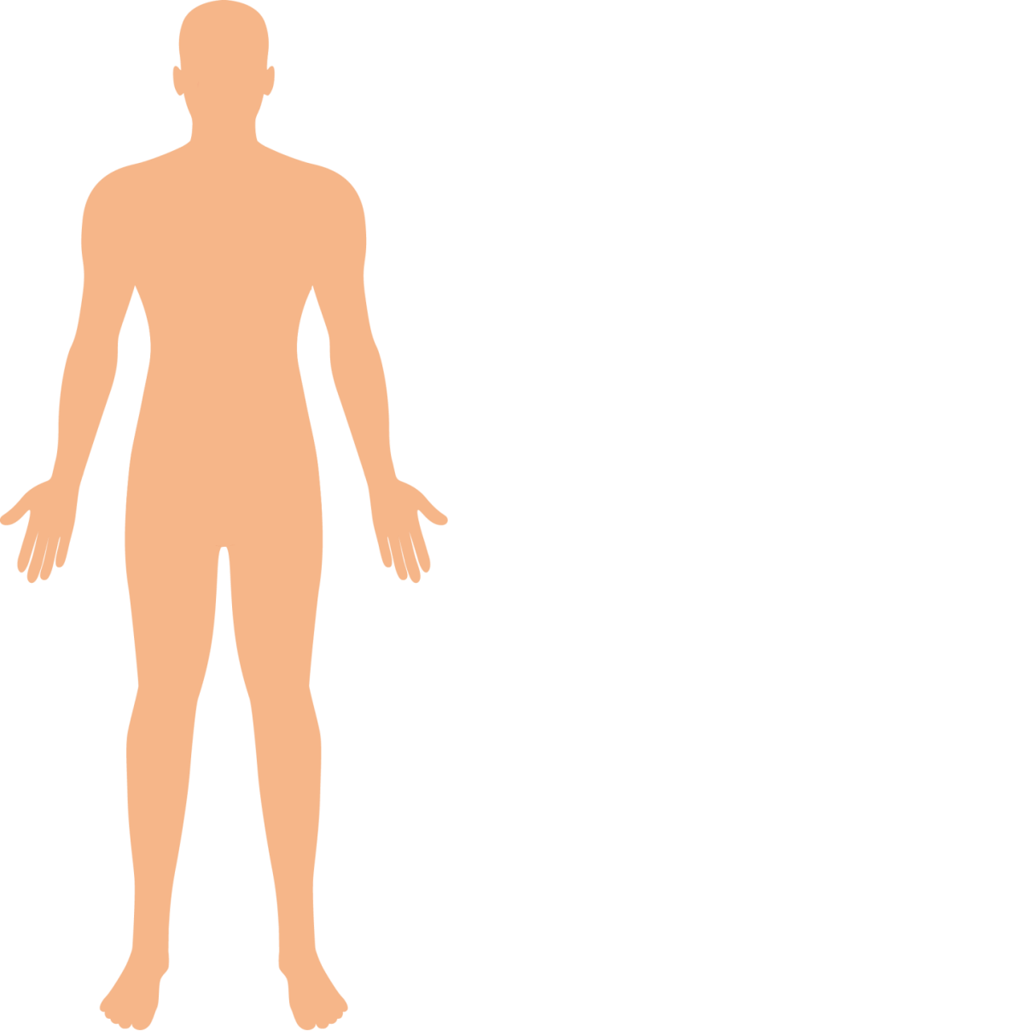
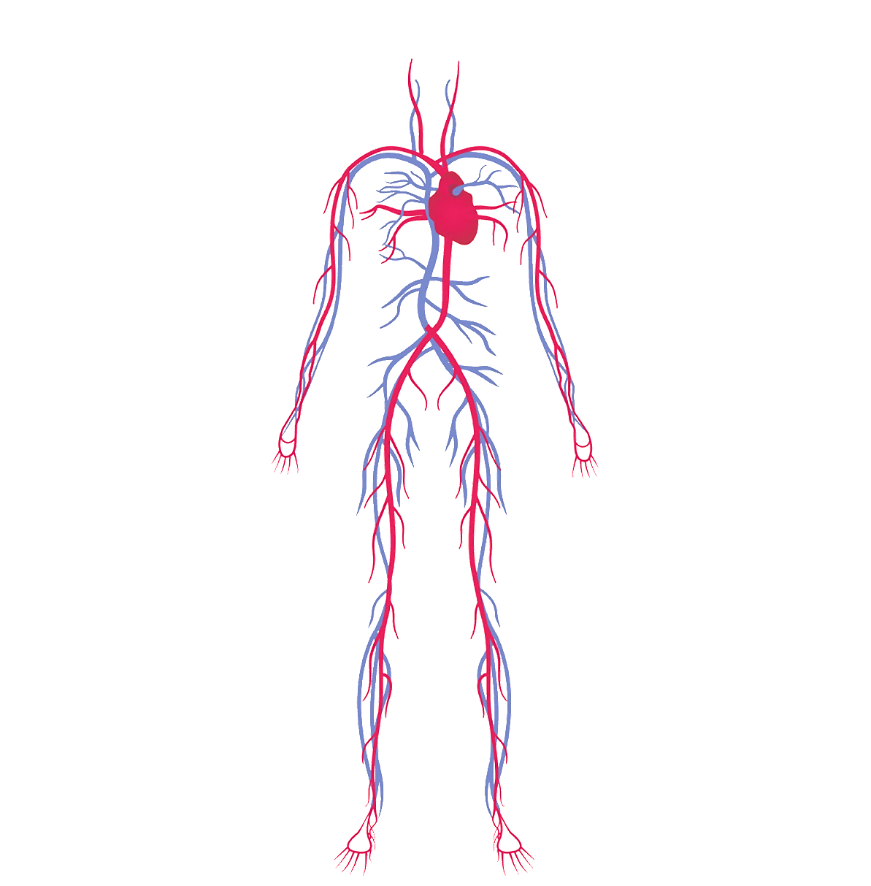


Background
Hypertension: blood pressure is too high
Global health issue: affect 1 in 5 people
Silent killer: no symptoms
Damage the body
Blood pressure is the key signal in the prevention and diagnosis of hypertension.

Slide 3
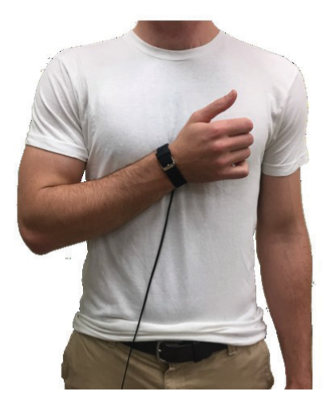
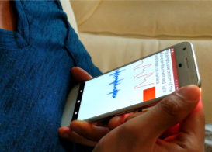
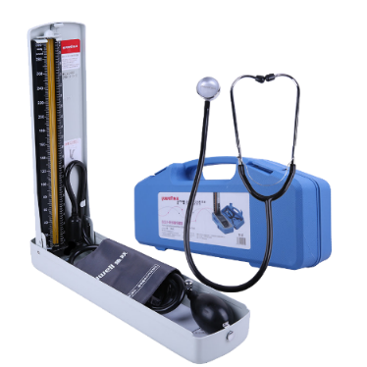
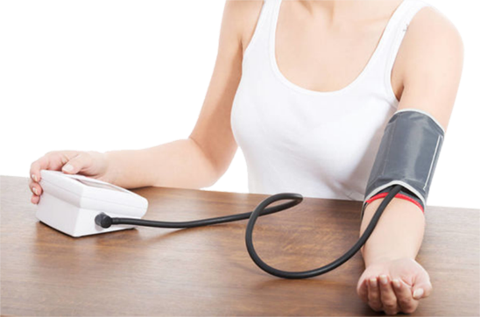
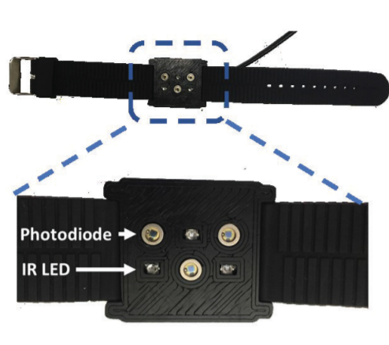
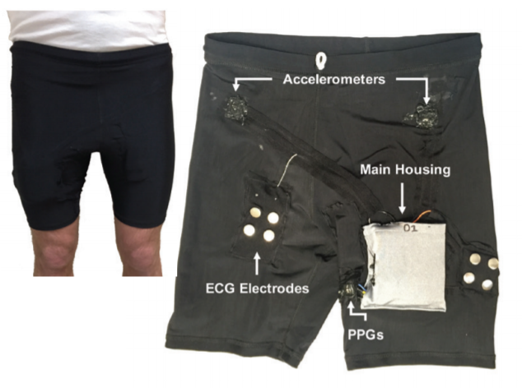
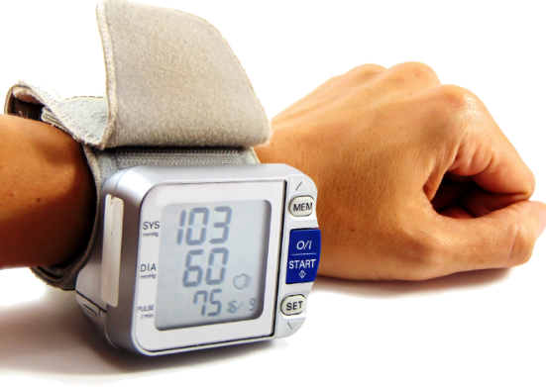
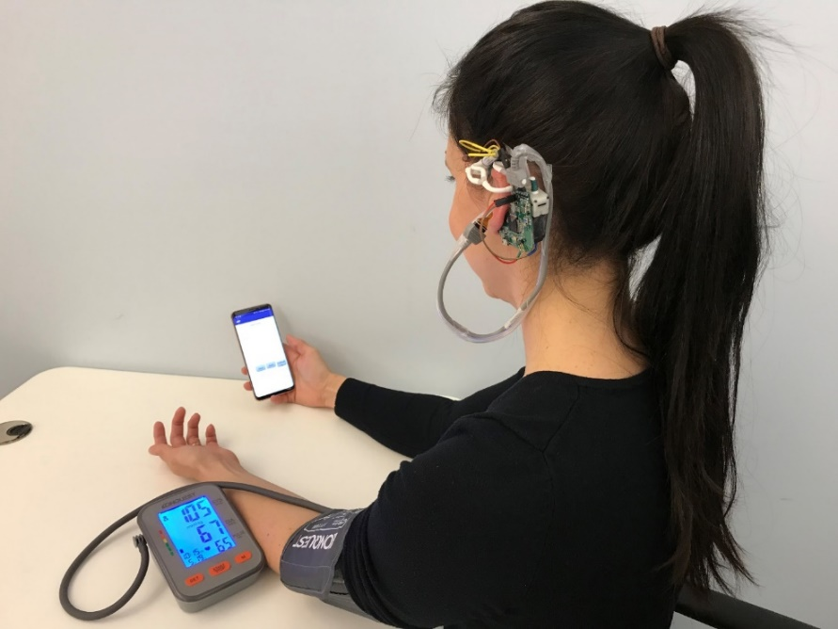
Current BP Monitoring Solutions
Contact-based BP Monitoring
Uncomfortable
Arm-cuff solutions
Unsuitable for individuals with sensitive or injured skin
Strict requirements on wearing position and pressure
Pulse wave velocity (PWV)-based solutions
Cuff-based wearable solutions

Slide 4
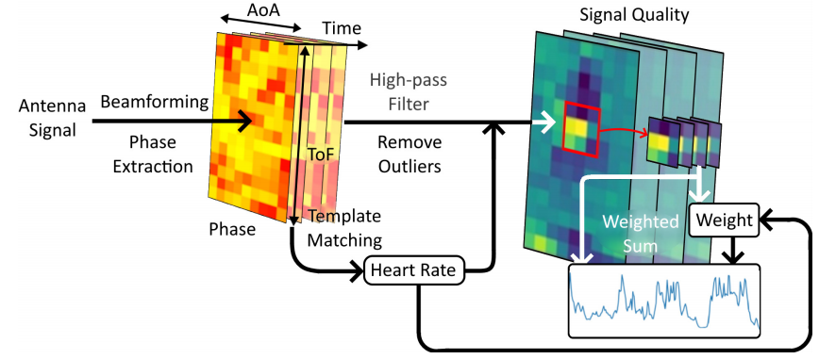
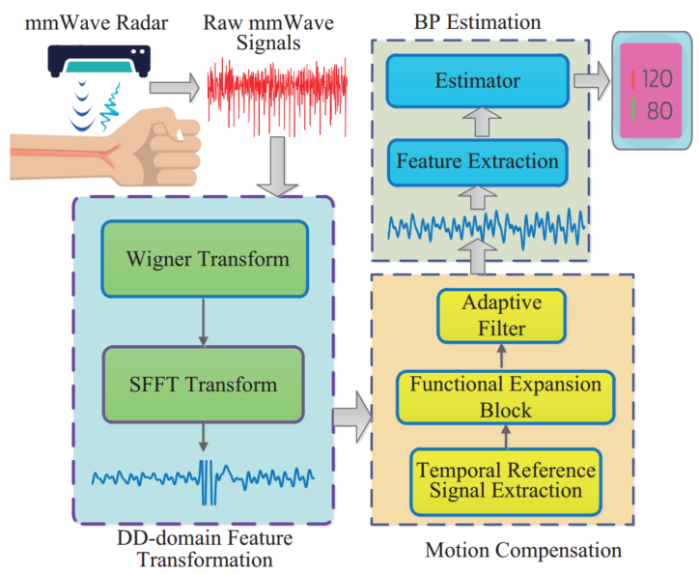
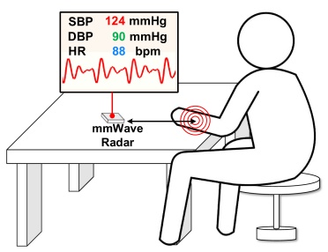
Current BP Monitoring Solutions
Contactless BP Monitoring: PWV-based solution is impractical!
Trust issue due to lack of a physiological basis
Contactless Blood Pressure Monitoring with mmWave Radar, IEEE GLOBECOM 22
airBP: Monitor Your Blood Pressure with Millimeter-Wave in the Air, ACM TIOT 23
mmBP: Contact-Free Millimetre-Wave Radar Based Approach to Blood Pressure Measurement, SenSys 22

Slide 5

Our Solution: hBP-Fi
BP-Encoded Hemodynamics
Related to BP
BP
Beam Scan
Compliance Changes
Varying Pulse Waveforms
Explainable DL
hBP-Fi associates advanced RF sensing and DL inference with a sound physiological basis.

Slide 6

Our Solution: hBP-Fi
BP-Encoded Hemodynamics
BP
How RF signals respond to hemodynamics?
How to capture varying pulse waveforms along the arm?
How to estimate BP explainablely？
Beam Scan
Compliance Changes
Varying Pulse Waveforms
Explainable DL

Slide 7
System Overview
We introduce BTF for correlating RF-captured pulse waveforms with BP.
We develop an explainable DL pipeline for BP inference.
We propose a continuous beam scan RF sensing scheme.

Slide 8
Hemodynamics Modeling via BTF
1
Blood pressure value

Slide 9
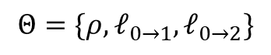
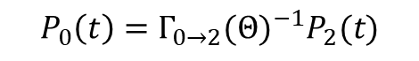
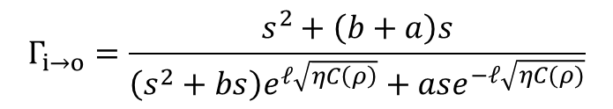
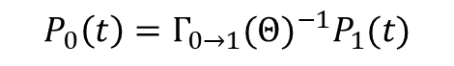
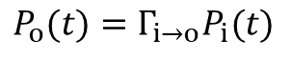
Hemodynamics Modeling via BTF
1
Blood pressure value
$$P_{o}(t)=Γ_{i→o}P_{i}(t)$$
$${P_{0}\left(t\right)=Γ}_{0→1}{(Θ)}^{−1}P_{1}(t)$$
$$Θ=\{ρ,ℓ_{0→1},ℓ_{0→2}\}$$
$${P_{0}\left(t\right)=Γ}_{0→2}{(Θ)}^{−1}P_{2}(t)$$
$$Γ_{i→o}=\frac{s^{2}+\left(b+a\right)s}{\left(s^{2}+bs\right)e^{ℓ\sqrt{ηC\left(ρ\right)}}+ase^{−ℓ\sqrt{ηC(ρ)}}}$$
$$\min_{Θ}{{\left\|Γ_{0→2}{\left(Θ\right)}^{−1}P_{2}\left(t\right)−Γ_{0→1}{(Θ)}^{−1}P_{1}(t)\right\|}_{2}}$$

Slide 10

RF Pulse Waveform Collection
2
How can we achieve a clearer separation of distinct areas?
Magnify the difference of the RF reflections from two neighboring sites!

Slide 11
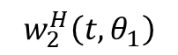
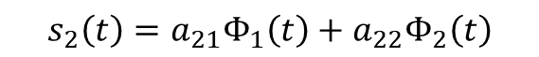
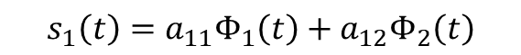
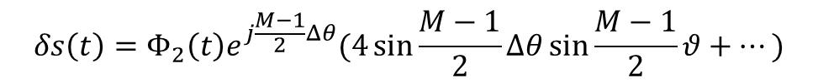

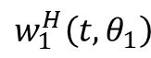
RF Pulse Waveform Collection
2
Null-steering
Super-Resolution Beam Scan
Pulse at site #1
Pulse at site #2
$${\text{y}}_{p}\left(t\right)=v\left(θ_{1}\right)Φ_{1}\left(t\right)+v\left(θ_{2}\right)Φ_{2}\left(t\right)$$
$$w_{1}^{H}\left(t,θ_{1}\right)$$
$$δs\left(t\right)=s_{2}\left(t\right)e^{j\frac{M−1}{2}θ}−s_{1}\left(t\right)e^{−j\frac{M−1}{2}θ}$$
$$s_{1}\left(t\right)=a_{11}Φ_{1}\left(t\right)+a_{12}Φ_{2}\left(t\right)$$
$$w_{2}^{H}\left(t,θ_{1}\right)$$
$$δs\left(t\right)=Φ_{2}\left(t\right)e^{j\frac{M−1}{2}Δθ}(4\sin{\frac{M−1}{2}Δθ}\sin{\frac{M−1}{2}θ}+…)$$
$$s_{2}\left(t\right)=a_{21}Φ_{1}\left(t\right)+a_{22}Φ_{2}\left(t\right)$$

Slide 12
RF Pulse Waveform Collection
2
Super-Resolution Beam Scan
Pulse Waveform Extraction
FMCW
mmWave Radar
RF reflections
Differential
IF signal
FFT
Radar data tensor
Phase variations

Slide 13
RF Pulse Waveform Collection
2
Super-Resolution Beam Scan
Pulse Waveform Extraction
BP results are not accurate enough!
BTF model fails to address influence of temperature and time of day on BP in real-world environments .

Slide 14
BP Inference
3
Structure & Searching Space
BTF model
DL Technique

Slide 15
BP Inference
3
Explainable DL Pipeline

Slide 16
Evaluation
Setup
TI AWR1843BOOST mmWave radar, 77GHz, 4G bandwidth, 3Tx, 4Rx
DCA 1000EVM data capture board, 200 frames/second
Data Collection
35 participants (22 male, 13 female, aging between 20 to 54)
Minimal body movement, hold breath
Varying environments
Varying radar placements
Ground Truth
Arm-cuff BP monitor
Standard procedure

Slide 17
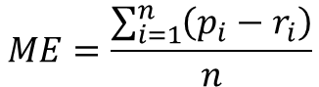
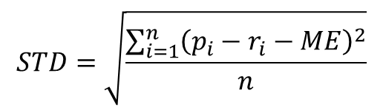
Evaluation
Metrics
Mean error
Standard deviation of mean error
$$ME=\frac{\sum_{i=1}^{n}{\left(p_{i}−r_{i}\right)}}{n}$$
$$STD=\sqrt{\frac{\sum_{i=1}^{n}{{\left(p_{i}−r_{i}−ME\right)}^{2}}}{n}}$$

Slide 18
Overall Performance
Mean error：
SBP -2.05 mmHg
DBP 1.99 mmHg
Standard deviation
SBP 6.83 mmHg
DBP 6.30 mmHg

Slide 19
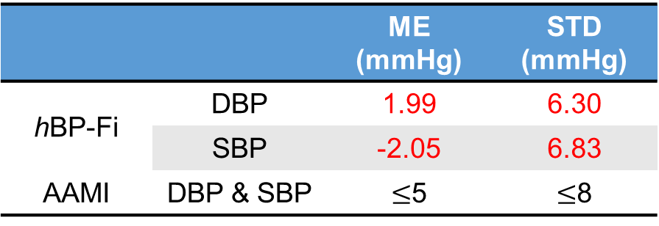
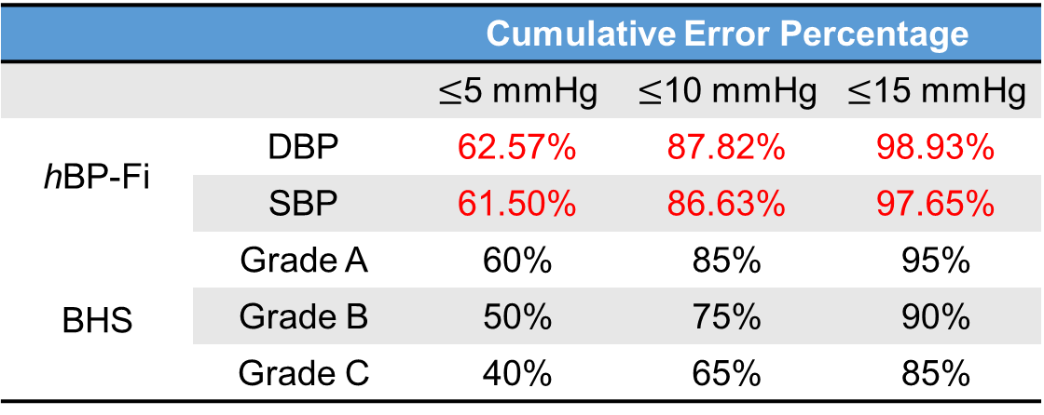
Overall Performance
Association for the Advancement of Medical Instruments
 |  | ME (mmHg) | STD (mmHg)
hBP-Fi | DBP | 1.99 | 6.30
 | SBP | -2.05 | 6.83
AAMI | DBP & SBP | $≤$5 | $≤$8
 |  | Cumulative Error Percentage
 |  | $≤$5 mmHg | $≤$10 mmHg | $≤$15 mmHg
hBP-Fi | DBP | 62.57% | 87.82% | 98.93%
 | SBP | 61.50% | 86.63% | 97.65%
BHS | Grade A | 60% | 85% | 95%
 | Grade B | 50% | 75% | 90%
 | Grade C | 40% | 65% | 85%
Britain Hypertension Society

Slide 20


Robustness
Varying environments
Varying radar placements
$$d$$
 |  | 30cm | 50cm | 70cm | 90cm
SBP | 0 | -2.05±6.76 | -2.04±6.72 | -2.35±7.21 | -3.47±7.12
 | 15 | -2.00±6.74 | -2.03±6.77 | -2.15±7.36 | -3.46± 7.61
 | 30 | -2.02±6.81 | -2.07±6.91 | -2.48±7.11 | -3.46±7.79
 | 45 | -2.06±6.92 | -2.05±6.85 | -2.10±7.20 | -3.48±7.77
DBP | 0 | 1.99±6.31 | 2.03±6.82 | 2.68±7.47 | 4.33±7.22
 | 15 | 2.07±6.30 | 2.04±6.51 | 2.69±6.63 | 3.34±7.30
 | 30 | 2.09±6.35 | 2.09±6.53 | 2.68±6.78 | 3.29±7.72
 | 45 | 2.03±6.34 | 2.06±7.72 | 2.69±7.28 | 3.36±7.87
$$ς$$
hBP-Fi is practical in real-world scenarios!

Slide 21
Conclusion
Target
Systems
Challenges
Solutions
Results
Unclear
Relationship
BTF Model
A sound physiological basis
Accurate BP results
Contactless BP Monitoring
hBP-Fi
Low Quality
Beam Scan
Inaccurate
Explainable DL

Slide 22


Thanks!
Thanks!
Thanks!
Q&A
Q&A
Q&A
Yetong Cao
yetong.cao@ntu.edu.sg
Jun Luo, IEEE Fellow
junluo@ntu.edu.sg
Google Scholar Page
Google Scholar Page

